Slide 1
ENEE 459F Final Project
Brian Zagalsky
Lukas Ozpaker

Slide 2
Objective
Goal: Design and implement an IEEE Standard Floating-Point Processor.
Operations:
Addition
Subtraction
Multiplication
(Optional) Division
Standards: Address IEEE rounding standards and corner cases.

Slide 3
Specifications

Slide 4
Input/Output Data Format
Inputs: 66-bit stream.
Output: 32-bit floating-point numbers (IEEE 754 format).
Operands: A and B in IEEE 754 single-precision format.
Op-codes:
00: Addition (A + B)
01: Subtraction (A - B)
10: Multiplication (A × B)
11: Division (A / B)

Slide 5
Adder Structures
Tree-structured Carry Lookahead Adders (CLA).

Slide 6
Multiplier Design
Wallace tree multiplier with Radix-4 Booth Encoding.

Slide 7
Connectivity
Host PC ↔ FPGA A: UART protocol.
FPGA A ↔ FPGA B: I2C protocol.
FPGA B ↔ OLED

Slide 8
Rounding Methods
Implemented: IEEE Standard Round to +Infinity.

Slide 9
Outputs
Results and inputs displayed on an OLED screen in HEX format.
Testing values entered in binary.

Slide 10
Simulation Details
Adder/Subtractor Module
I2C (Master/Slave)
Multiplier Module
FPGA B Simulation

Slide 11
FPGA Allocation
FPGA A: Addition and Subtraction.
FPGA B: Multiplication.

Slide 12
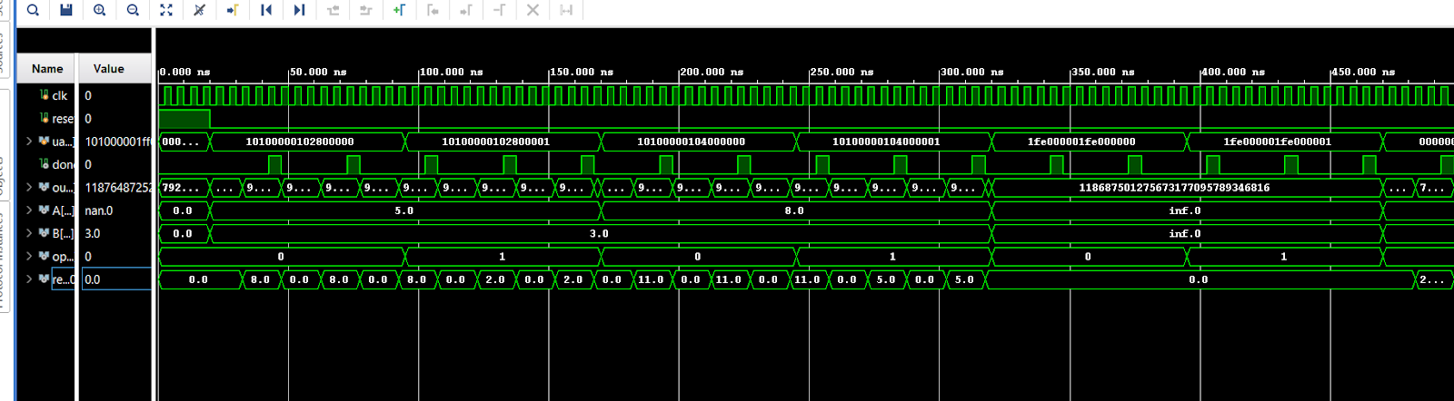
Adder/Subtractor Simulation

Slide 13
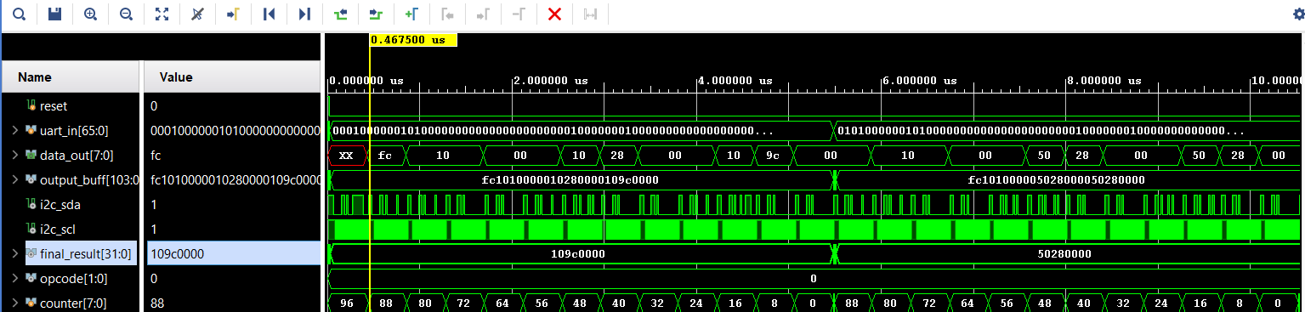
I2C Simulation

Slide 14
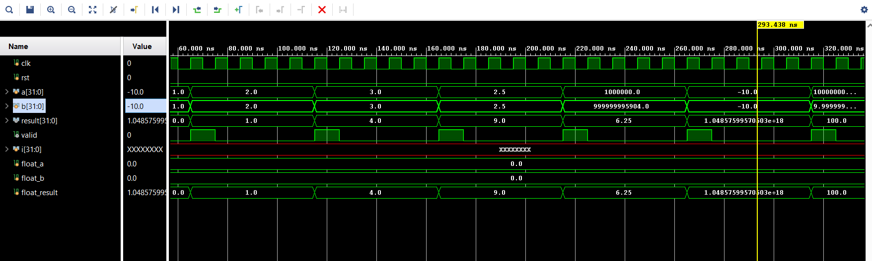
Multiplier Simulation

Slide 15
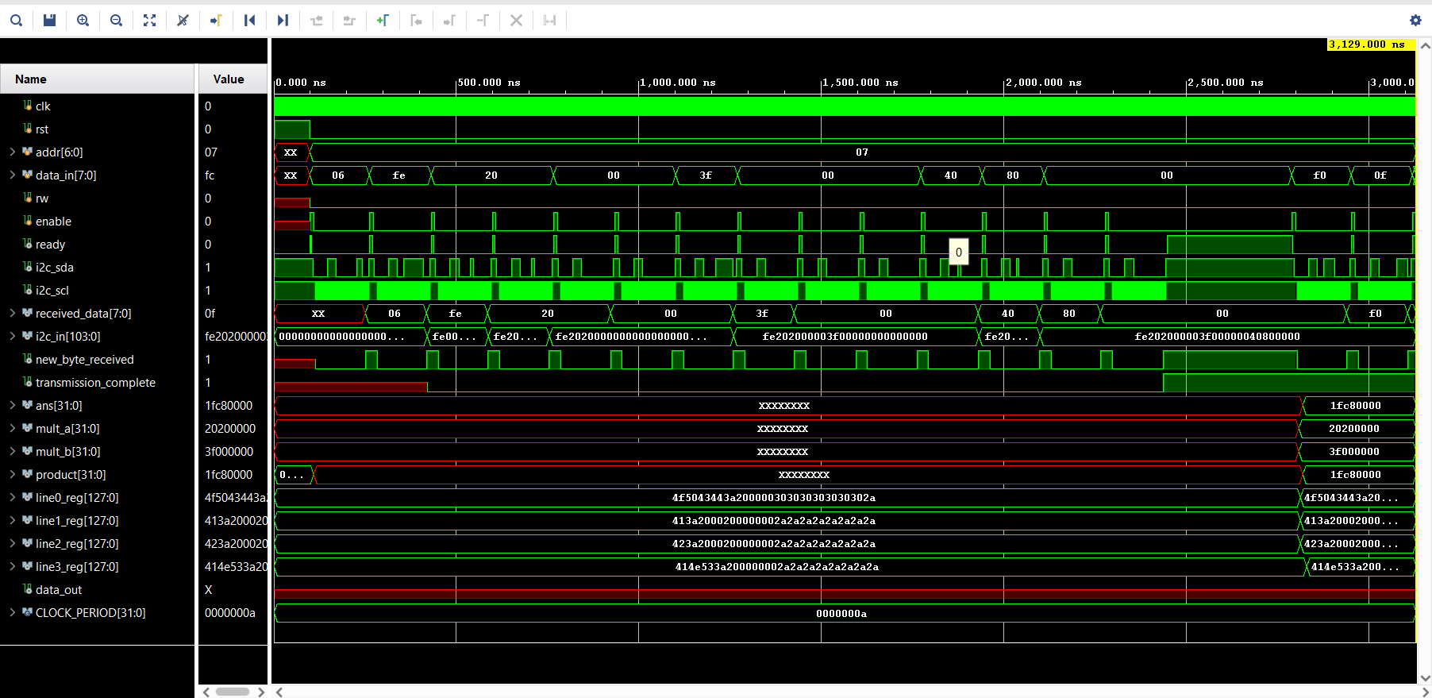
FPGA B

Slide 16
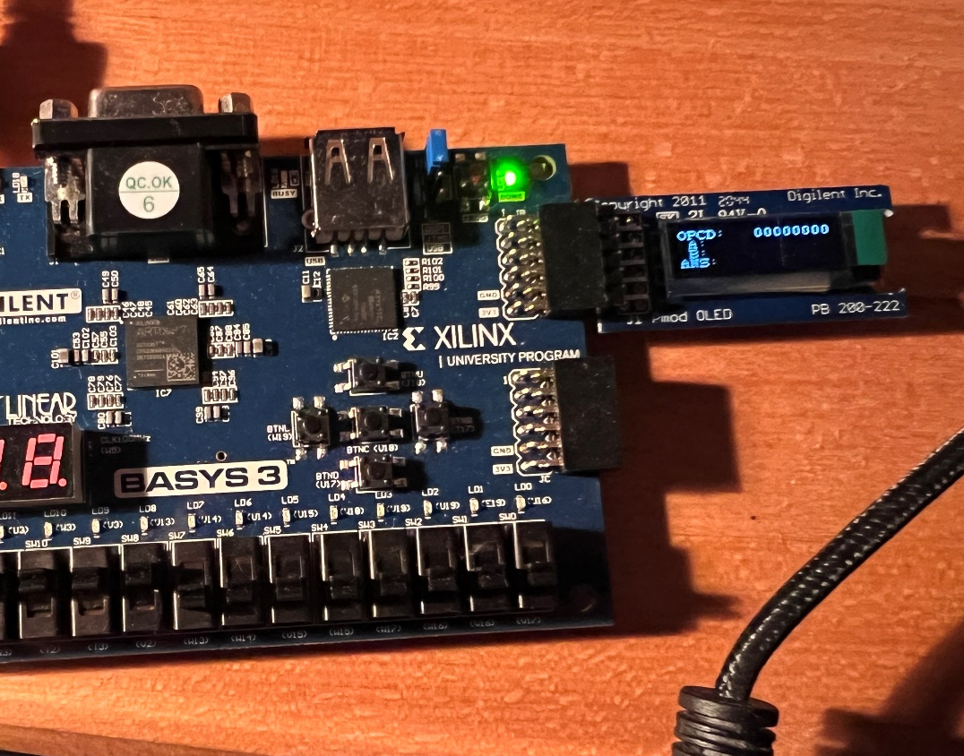
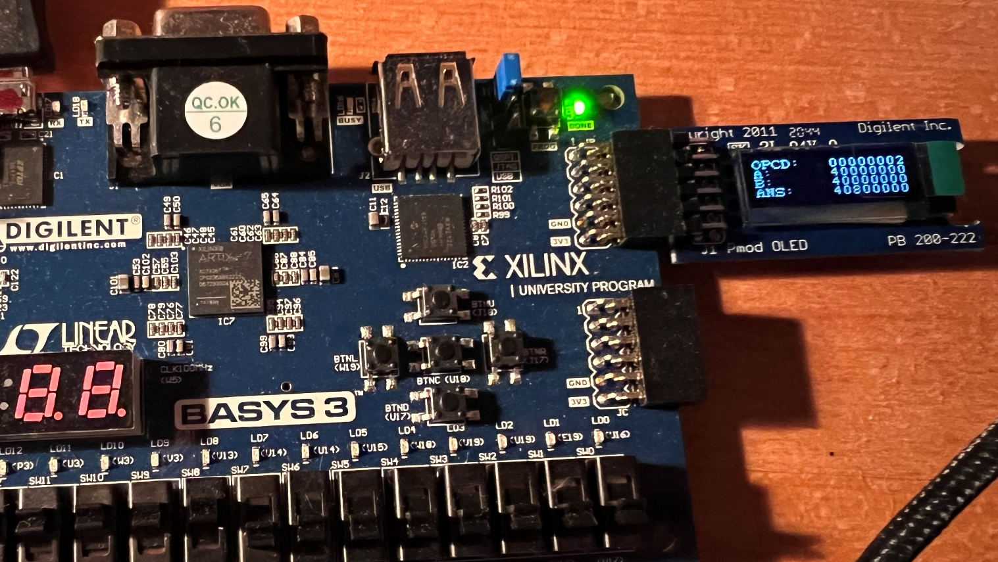
FPGA B

Slide 17
Demo

